Slide 1

Bader Almatouq, Kai Brooks, Andrew Forsman, Jeff Roman
ECE 411 Team 18

Slide 2
THE PROBLEM
Traditional synthesizers are overproduced, bulky, and lack an air of janky street-style that commands respect during a live performance for an indie musician.
Playing electronic instruments is typically limited to keyboards, drum pads, or similar digital controllers: few options for interesting analog devices.
Commercial instruments separate effects devices from generative devices.
Watching musicians play synthesizers is uninspiring and often makes one question the ticket price.
Notes:
What is the problem being solved? Where does it arise?

Slide 3
THE MOTIVATION
THEREMIZER exists from a desire to create an affordable, interesting device with a unique sound, that the user can play as a synthesizer, or use as an effect modulator for an external instrument.
THEREMIZER produces unique sounds unlike anything else on the market.
THEREMIZER is interesting to watch musicians play live.
Notes:
Why is it important? What is the value of a solution (lives, money, effort, energy saved)?

Slide 4
THE GOAL
Produce a working prototype.
Learn more about designing Theremins/synthesizers to improve future designs.
Show potential customers the novelty of our design.
Notes:
What is the specific objective of this project? A design? A working prototype?

Slide 5
THE OTHER GUYS
THEREMIZER breaks from traditional synthesizers by combing a musical instrument with an effects box, and allows open-hand analog play.
THEREMIZER is affordable, economical to produce at scale, and easy to transport.
THEREMIZER is exciting to watch a musician play live
Notes:
How is it done today or what other alternatives exist?

Slide 6
The REQUIREMENTS
Antenna modulating frequency, heterodyned with another frequency.
Range of one (1) octave.
Output able to feed to other audio processing blocks
Accept and modulate an external signal and mix it against theremin input.
User controlled filter with 5kHz cutoff.
Output impedance between 600Ω and 10kΩ
Notes:
What are the requirements for an acceptable solution?

Slide 7
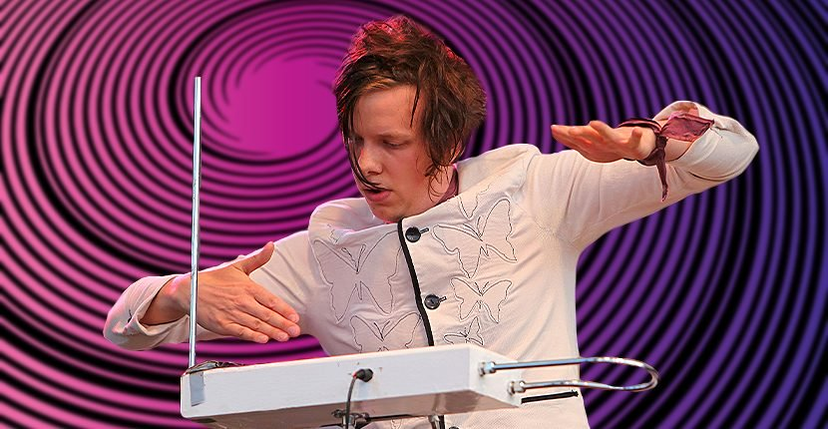
How it works
Wave your hand
Pitch changes
Turn knobs
Volume/sound changes
Play external instrument
Sound changes
Notes:
Brief overview of your approach and your project schedule

Slide 8
Approach
Focus on strengths while giving a chance to learn new skills (Eagle, Git, Etc.)
Good communication - Slack
Explain/crosstrain on what we were each working on
Meet in person at least once a week
Willing to put in more than bare minimum (2 credit hours) knowing we chose a difficult but rewarding project
Notes:
Brief overview of your approach and your project schedule

Slide 9
THE DESIGN – Trade offs
Low Pass filter
Classic predesigned vs our design
Oscillators
Stability for low frequency – (Crystal vs Discrete)
Envelope Modulator
Taking more time vs finishing project
Digital CV vs Analog CV – Didn’t compromise, did both
Notes:
May need multiple sub-headings here (e.g. H/W and S/W, or multiple subsystems) Describe design using appropriate methods (e.g. block diagrams, UML models, algorithms) Discuss design alternatives, trade-offs, decisions made

Slide 10
THE DESIGN – Software
Initialize needed variables
2 ints to store pwm output pin values
2 ints to store analog input pin values
2 ints to store analog reading values
2 ints to store values to be written to output pins
Set associated pins to be outputs
Loop (forever):
Read analog input value for first pwm 1 output
Map analog input value to different scale (for pwm value) to generate an output between 0% and 5% duty cycle
Write pwm value to pwm 1 output pin
Delay
Repeat above for pwm 2
Go back to top of loop
Notes:
May need multiple sub-headings here (e.g. H/W and S/W, or multiple subsystems) Describe design using appropriate methods (e.g. block diagrams, UML models, algorithms) Discuss design alternatives, trade-offs, decisions made

Slide 11
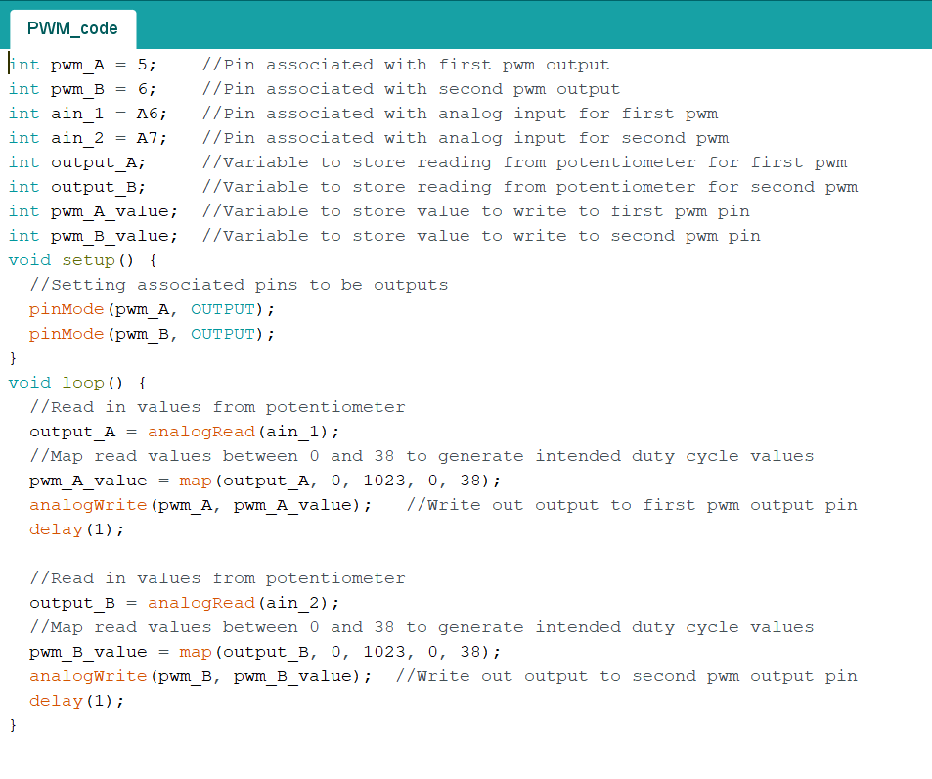
Notes:
May need multiple sub-headings here (e.g. H/W and S/W, or multiple subsystems) Describe design using appropriate methods (e.g. block diagrams, UML models, algorithms) Discuss design alternatives, trade-offs, decisions made

Slide 12
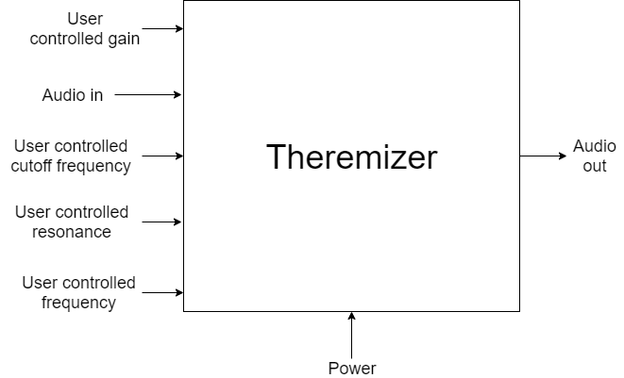
THE DESIGN-Level 0
Notes:
May need multiple sub-headings here (e.g. H/W and S/W, or multiple subsystems) Describe design using appropriate methods (e.g. block diagrams, UML models, algorithms) Discuss design alternatives, trade-offs, decisions made

Slide 13
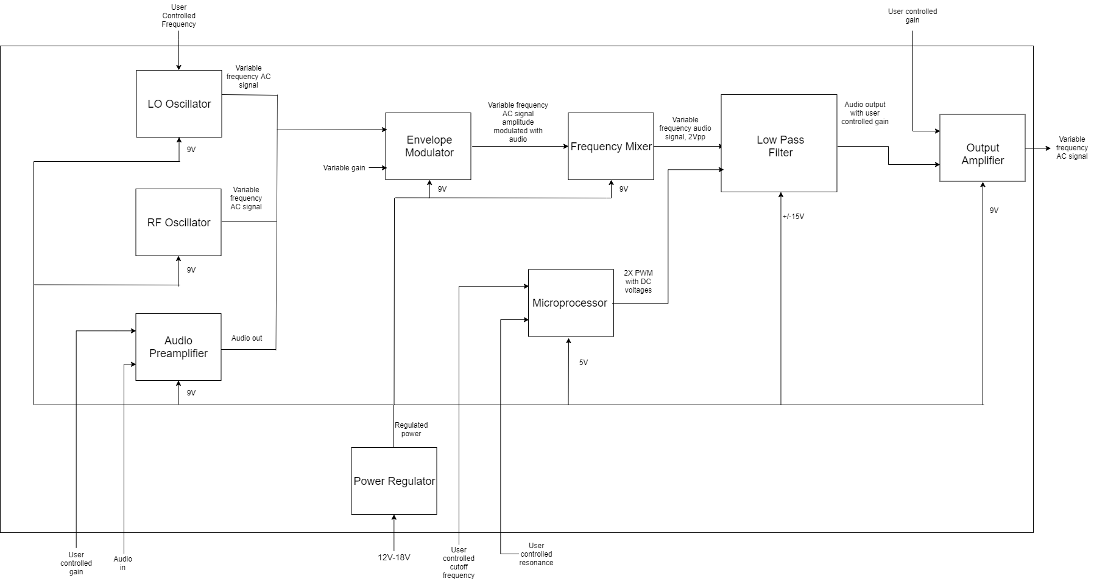
THE DESIGN – Level 1
Notes:
May need multiple sub-headings here (e.g. H/W and S/W, or multiple subsystems) Describe design using appropriate methods (e.g. block diagrams, UML models, algorithms) Discuss design alternatives, trade-offs, decisions made

Slide 14
Implementation - Tools
Autocad EAGLE
Atmel Studio
Arduino IDE
LTSpice
Notes:
May need multiple sub-headings here (e.g. H/W and S/W, or multiple subsystems) Describe design using appropriate methods (e.g. block diagrams, UML models, algorithms) Discuss design alternatives, trade-offs, decisions made

Slide 15
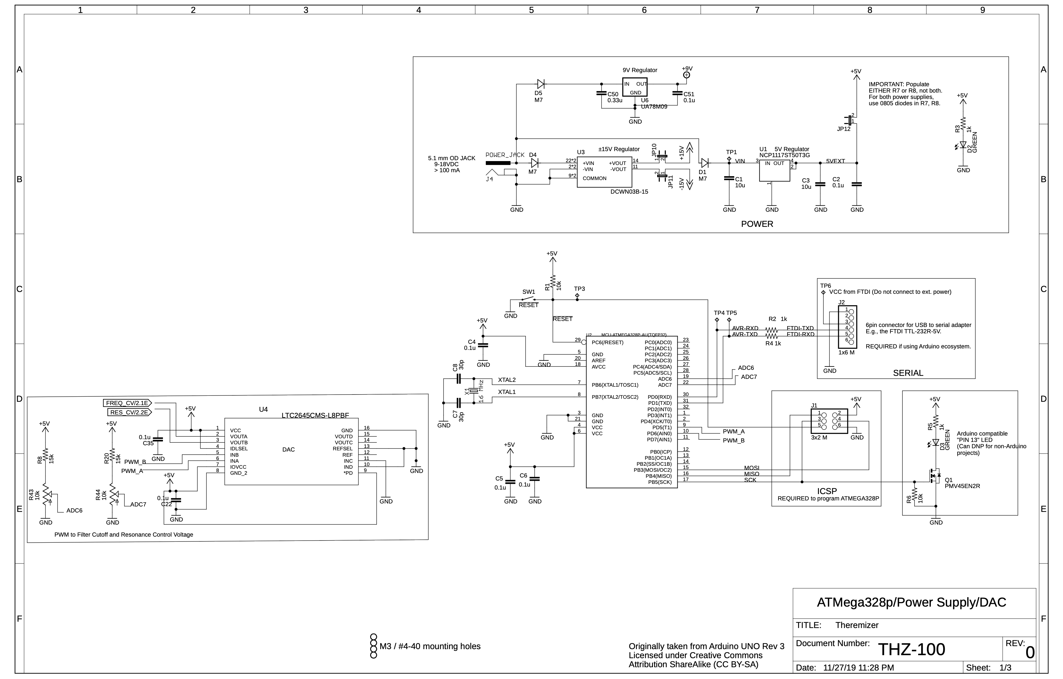
Notes:
Details of implementation (major components, schematics, board layout, code) Tools employed (e.g. simulation/modeling tool, PCB layout, IDE, cross-compilers) Bill of materials (with costs, per unit cost)

Slide 16
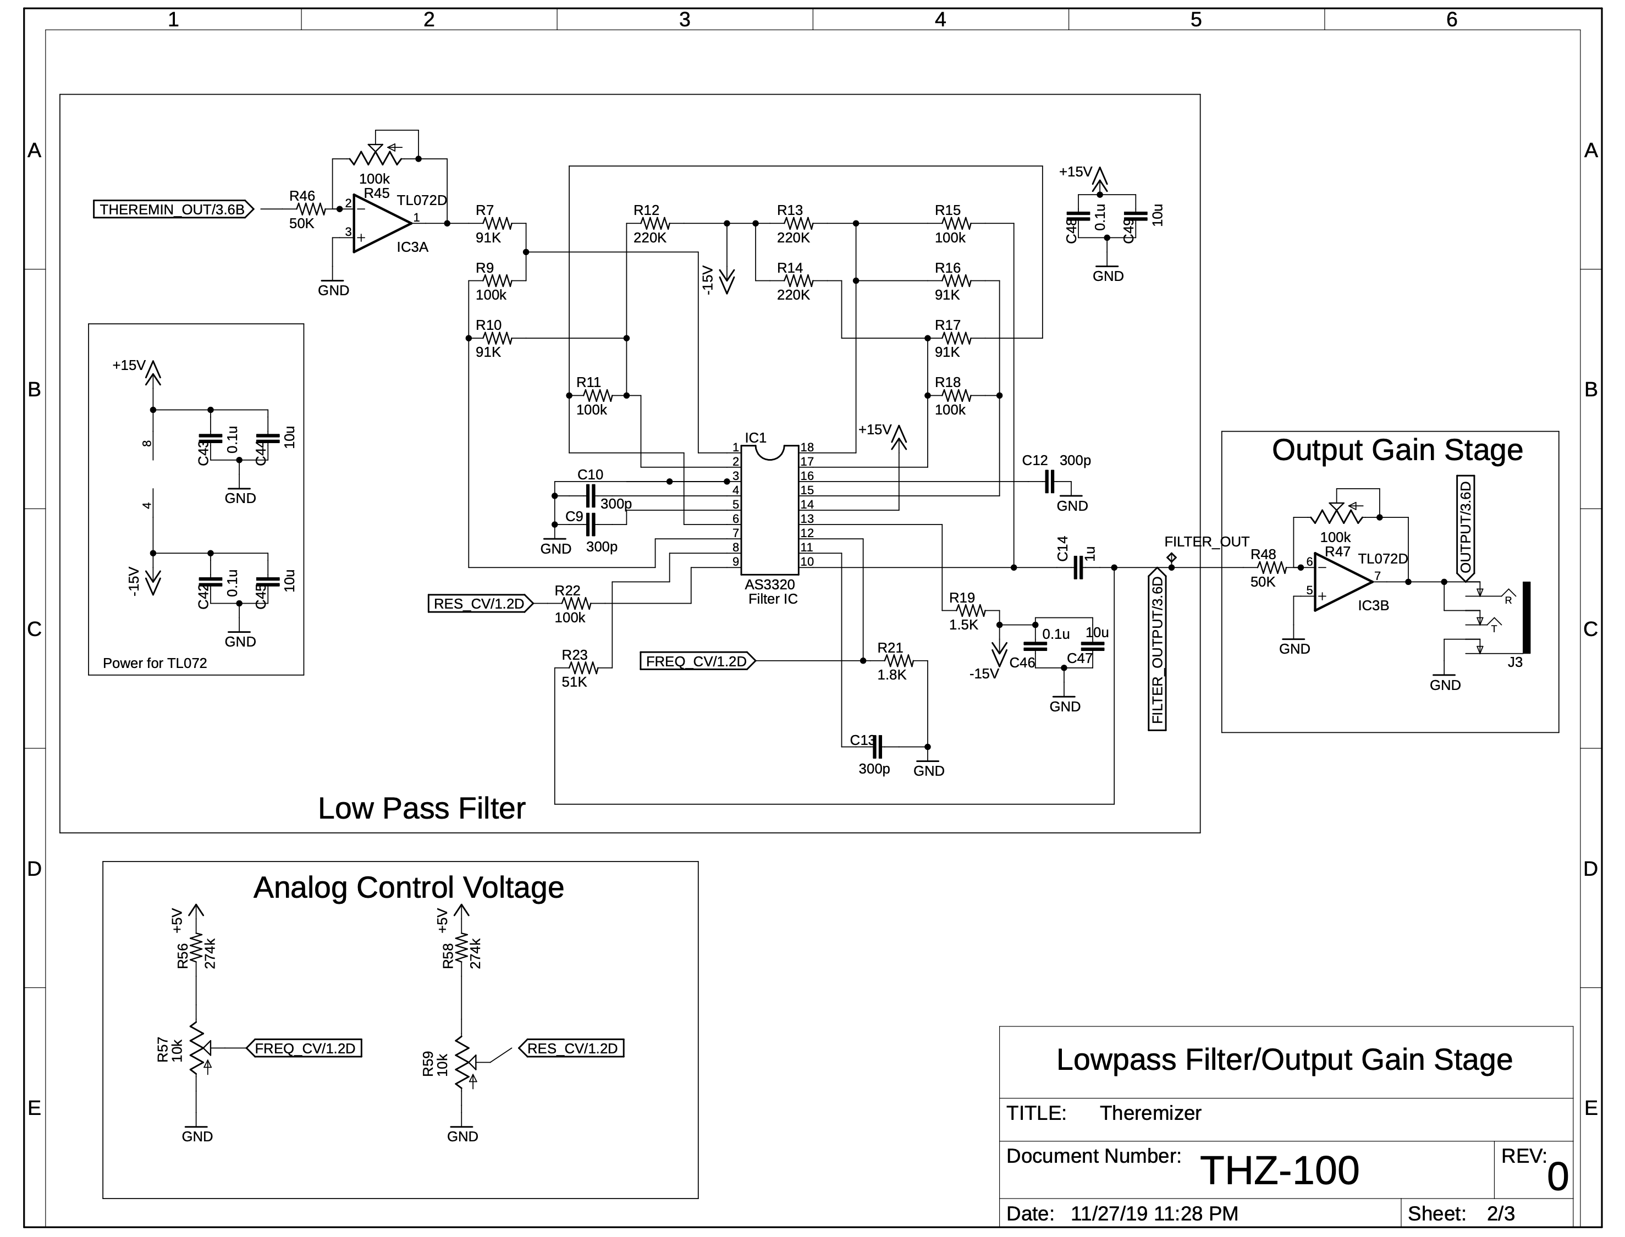
Notes:
Details of implementation (major components, schematics, board layout, code) Tools employed (e.g. simulation/modeling tool, PCB layout, IDE, cross-compilers) Bill of materials (with costs, per unit cost)

Slide 17
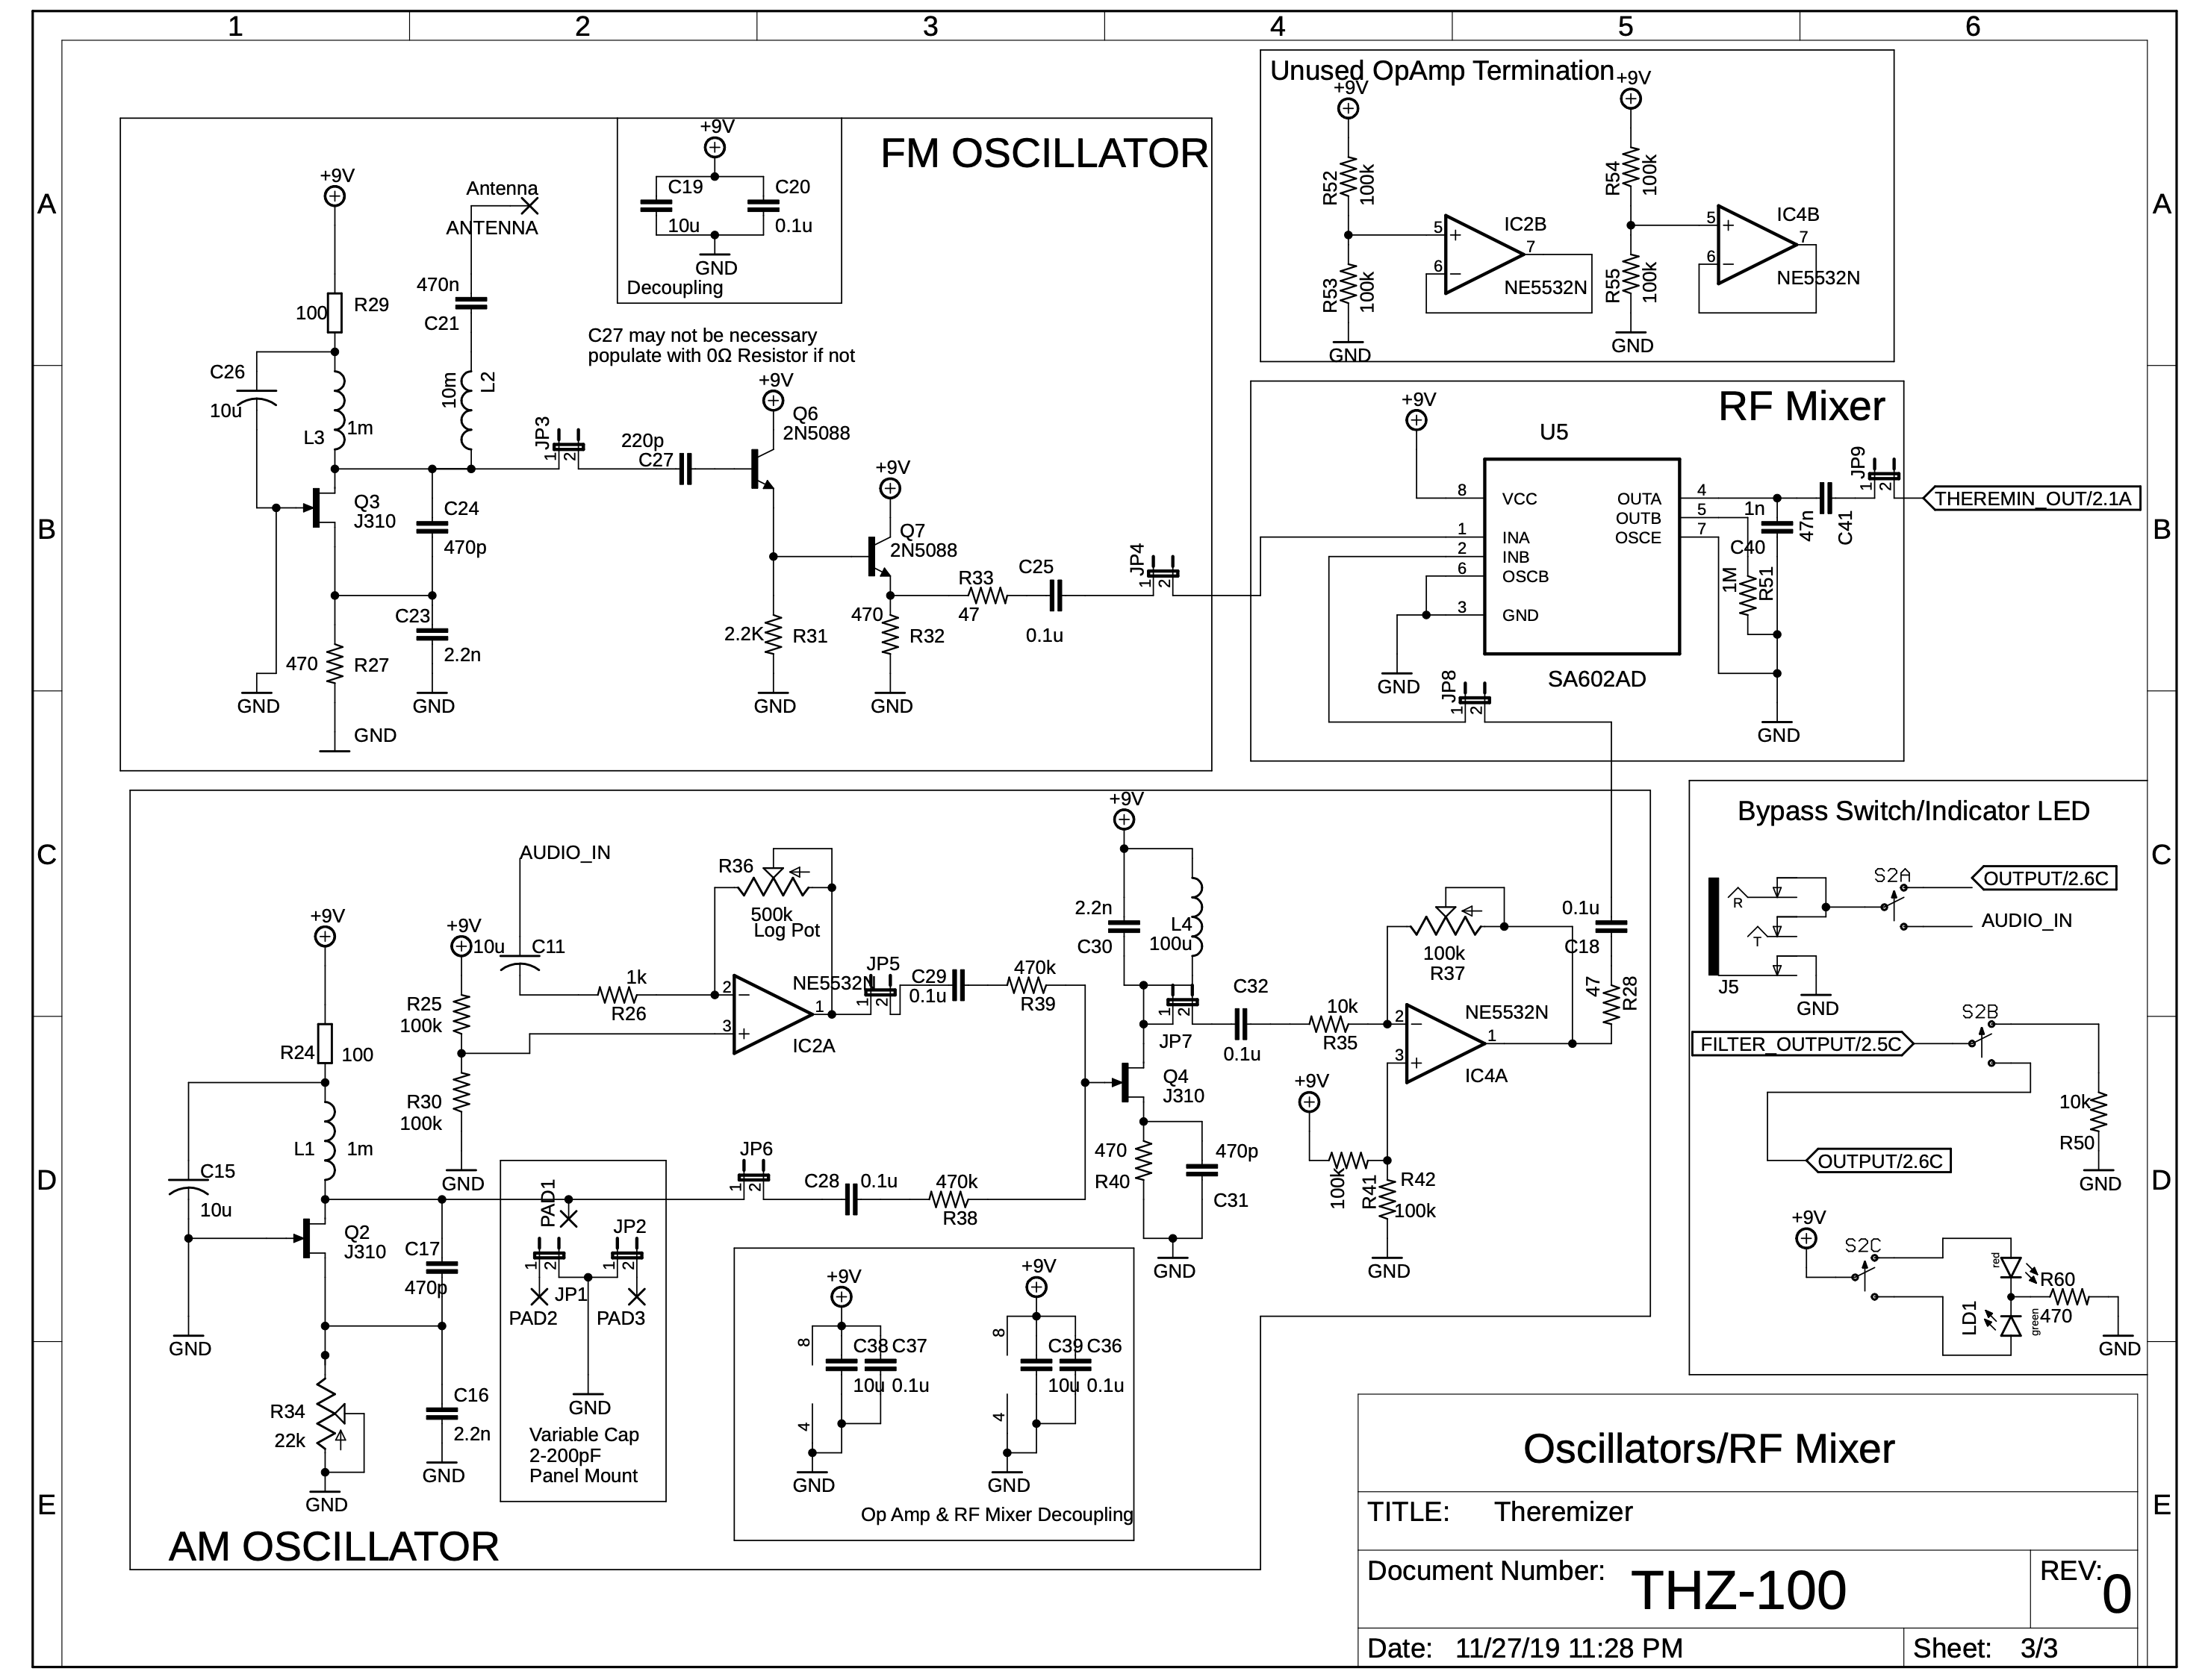
Notes:
Details of implementation (major components, schematics, board layout, code) Tools employed (e.g. simulation/modeling tool, PCB layout, IDE, cross-compilers) Bill of materials (with costs, per unit cost)

Slide 18
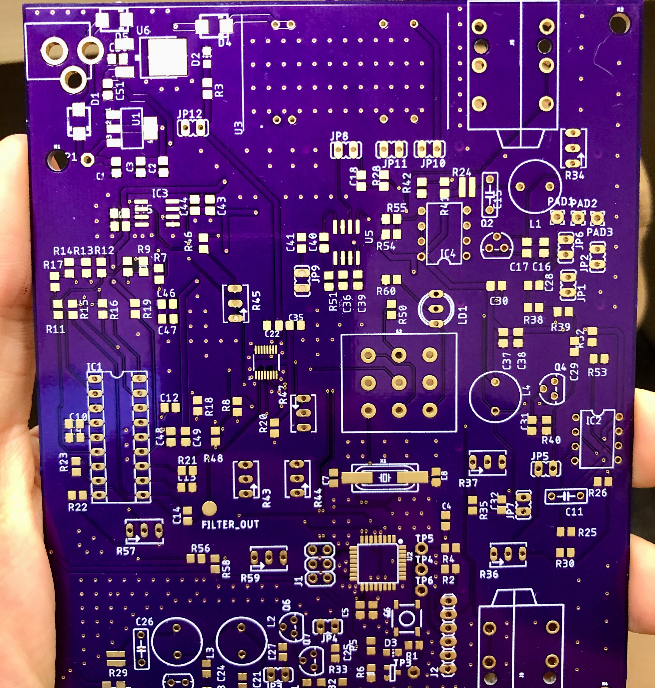
THE BUILD
Total Parts cost: $347.50
Cost per unit: $86.75
…et
Notes:
Details of implementation (major components, schematics, board layout, code) Tools employed (e.g. simulation/modeling tool, PCB layout, IDE, cross-compilers) Bill of materials (with costs, per unit cost)

Slide 19
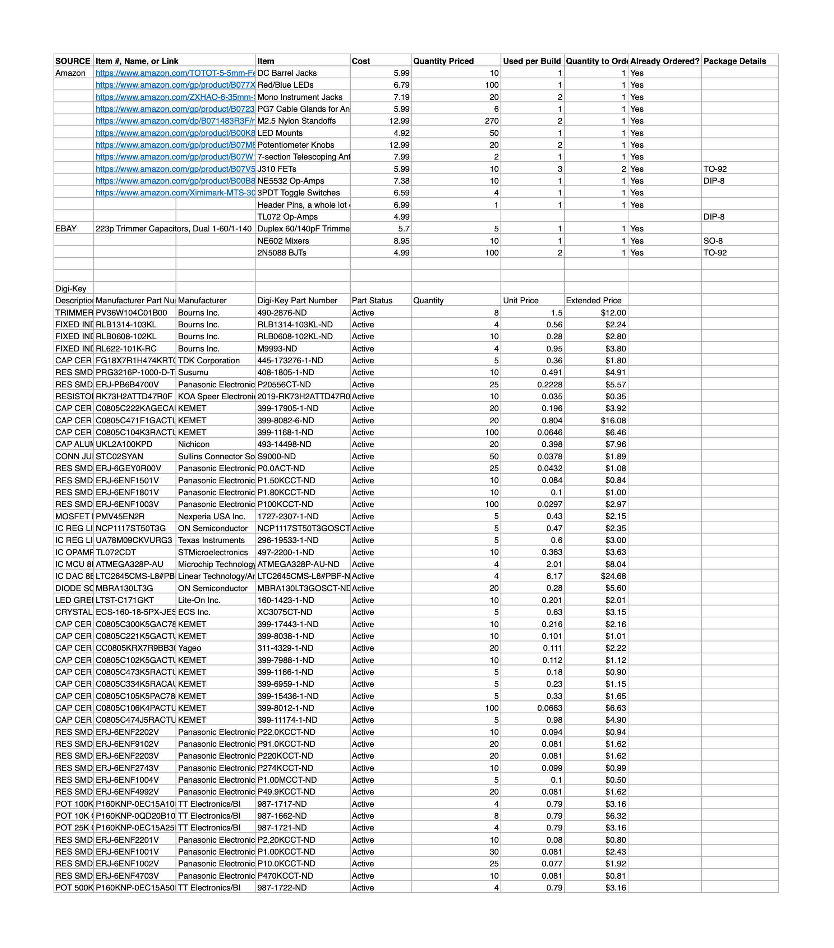
THE BOM
Total Parts cost: $347.50
Cost per unit: $86.75 – 4 Units
Cost per unit at scale will be less
Notes:
Details of implementation (major components, schematics, board layout, code) Tools employed (e.g. simulation/modeling tool, PCB layout, IDE, cross-compilers) Bill of materials (with costs, per unit cost)

Slide 20
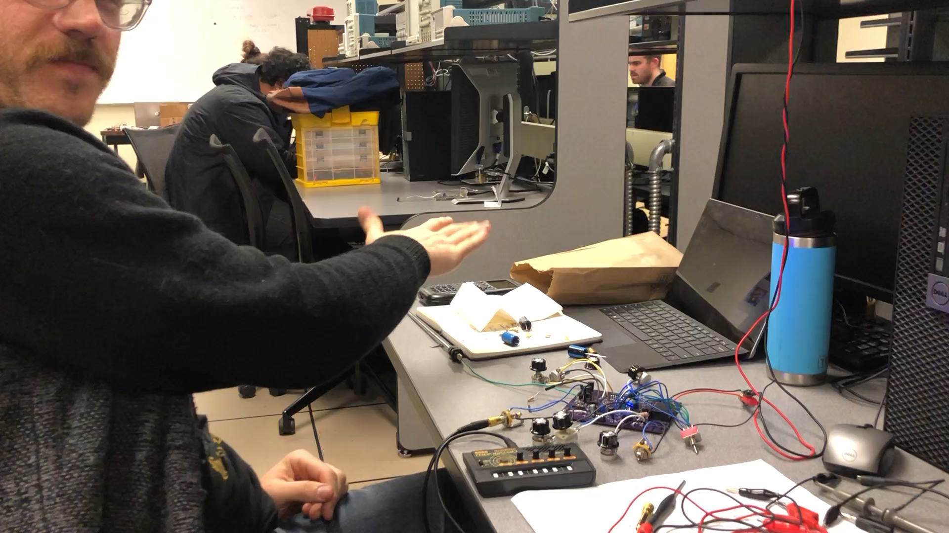
THE RESULTS
Notes:
What worked? How well? What didn’t work? Why? Include data and graphics/charts/plots where appropriate.

Slide 21
THE IP
Theremin is a ‘prior work’, though not an instrument under patent.
Used example code found online as starting point
Greenberg’s Atmel328p layout was starting point.
Arduino Bootloader
Notes:
Brief summarize what use you made of prior work or IP including but not limited to ideas, designs,
schematics, board layouts, code.

Slide 22
THE TEST – General Approach
Test sections individually using unconnected jumpers
Once each section was working, connect jumpers and test functionality
Tested functionality of code on breadboard to guarantee intended results.
Loaded code to on board chip and tested with working board.
Notes:
What was the testing strategy and plan?

Slide 23
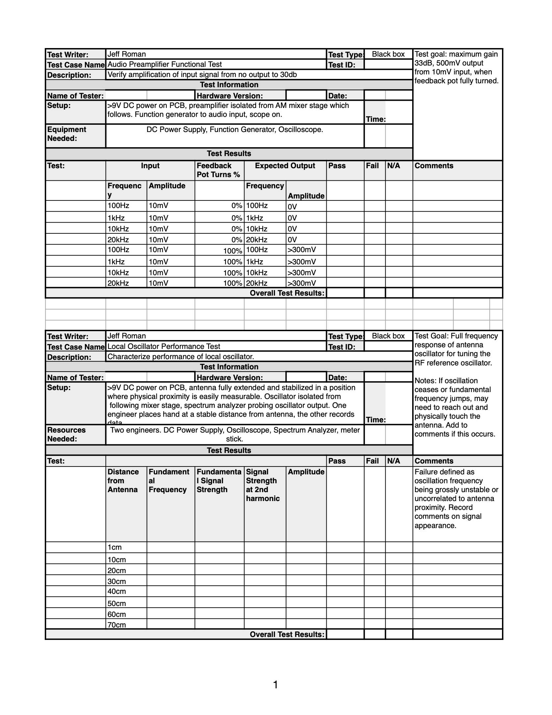
THE TEST
Audio Preamplifier Functional Test Verify input gain from 0-30dB
Local Oscillator Performance Test Full frequency response of antenna oscillator for tuning the RF reference oscillator.
Audio Preamplifier Verification Test Maximum gain 33dB, 500mV output from 10mV input, when feedback pot fully turned
Notes:
What was the testing strategy and plan?

Slide 24
THE MASTERMINDS
BADER Digital design and test
KAI QC, project organization, patent filing
ANDREW Analog design and fabrication
JEFF Analog design and fabrication
Notes:
What were the contributions of each member (e.g. who did PCB, coding, testing, writing)?

Slide 25
THE LESSON
Don’t do such a complicated process
Notes:
What did each member of the team learn as a result of the project (technical, skill, personal)? What would you do differently?

